Slide 1
Tavistock Infant School
Information Update Evening 2015

Slide 2
Aims of the Evening
To update you on our curriculum and assessing without levels.
To look in detail at the teaching of spelling.
To give you an opportunity to look at progress in your child’s books.

Slide 3
Our Curriculum

Slide 4
Our Curriculum
We are in the 2nd year of working with the new National Curriculum, which was set by the DfE.
Our curriculum incorporates both the National Curriculum and the ethos of our school.
We have chosen a 2-year rolling programme for topic work.

Slide 5
How we designed our curriculum.

Slide 6
Strengths of our curriculum
Based on ‘Achieving Happily Together’.
It is driven by the principles of Visible Learning, positive mindsets and RRR.
Our new topics have been a huge success ensuring children’s motivation and engagement in their learning.
Children learn through a range of experiences within each topic.

Slide 7
Assessing Without Levels.

Slide 8
In our school
As professionals we assess children’s learning through:
assessment matrices
planning
marking
conversations with children
HT drop ins, monitoring and observations
external monitoring and observations
HT reports termly to Governors, who also have a monitoring schedule
continuous CPD for all staff.

Slide 9
Since October…
We have attended cluster meetings for English and Maths where we have moderated our standards against other schools and national expectations.
Carried out our first internal assessments of reading, writing and maths in KS1 to track children’s progress towards reaching ARE.
Analysed our data and continued to use our marking to plan next steps.
Continued to explore the notion of mastery and deep learning.

Slide 10
Assessing without levels
Met is an indication that children have achieved the Age Related Expectation (ARE) for their year group.
We will be using colours to enable children to assess their own level of understanding/learning in line with the colours on the gauge.

Slide 11
Writing Year 1

Slide 12
Deep Learning

Slide 13
Blooms Taxonomy

Slide 14
Angles
Know it!
90 º = right angle
?
180 º = straight line
?
?
360 º = full turn
270 º = ¾ turn
?
180 º = triangle
?
?
Opposite angles are always EQUAL
?
Corresponding angles are always EQUAL

Slide 15
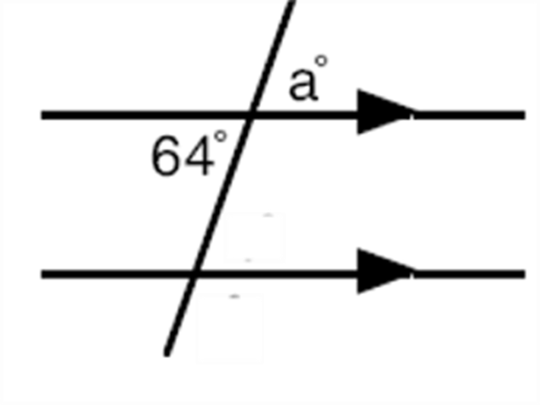
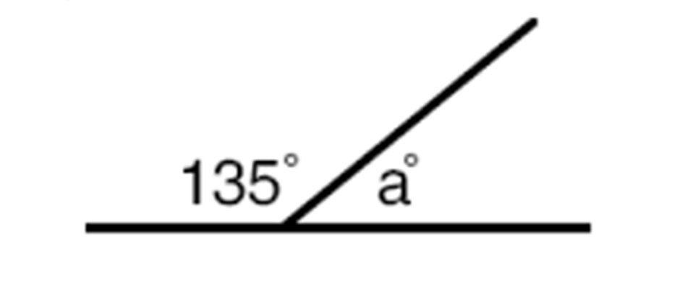
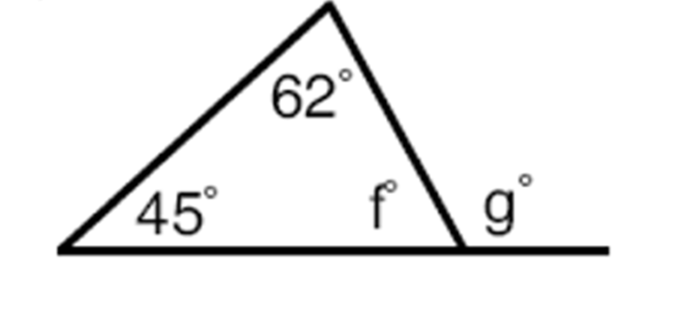
Use it!

Slide 16
Explain it!

Slide 17
Spelling at Tavistock Infant School

Slide 18
National Curriculum Year 1
Children should be taught to spell:
words containing each of the 40+ phonemes already taught
common exception words
the days of the week
words with prefixes and suffixes
words using the spelling rule for adding –s or –es to make plurals
words using the prefix un
words using –ing, –ed, –er and –est where no change is needed in the spelling of root words [for example, helping, helped, helper, eating, quicker, quickest]
by writing from memory, simple sentences dictated by the teacher that include words using the GPCs and common exception words taught so far.

Slide 19
National Curriculum Year 2
Children should be taught to:
segment spoken words into phonemes and represent these by graphemes, spelling many correctly
learn new ways of spelling phonemes for which one or more spellings are already known, and learn some words with each spelling, including a few common homophones
spell common exception words
spell more words with contracted forms
learn the possessive apostrophe (singular) [for example, the girl’s book]
distinguish between homophones and near-homophones
add suffixes to spell longer words, including –ment, –ness, –ful, –less, –ly
write from memory simple sentences dictated by the teacher that include words using the GPCs, common exception words and punctuation taught so far.

Slide 20
What Does The Research Say?
Teaching children strategies for correcting spelling is far more important than giving them the correct spelling of a word.
If children learn spellings for tests and don’t use those words in their own writing, they will forget them within days.
Children need to be taught why words are spelt as they are. There’s a need for both schools and parents to spend more time on the basics.
Notes:
Vineeta Gupta, head of children’s dictionaries for OUP and OUP lexicographer Jane Bradbury

Slide 21
Spelling of Common Exception Words
Spelling Test Problems
Children rarely commit spellings learnt for a test to their long-term memory.
Some get 10/10 but then fail to spell these words correctly in their writing.
Can lead to poor self-esteem for children who practise but then don’t get many correct.
Can create an unhealthy competition.
Gives teachers little information about the spelling skills children need to develop.

Slide 22
Delivering the Spelling Curriculum
Year 1
Phonics x 4 weekly
Spelling lesson x 1 weekly
Common exception word spelling homework and half termly test.
Phonics/spelling investigation homework
English teaching sequences
Year 2
Spelling & grammar lessons x 4 weekly
Spelling lesson x 1 weekly
Common exception word spelling homework and half termly test.
Spelling investigation homework
English teaching sequences

Slide 23
Year 1 Common Exception Words
the | a | do | to | today | of | said
says | are | were | was | is | his | has
I | you | your | they | be | he | me
she | we | no | go | so | by | my
here | there | where | love | come | some | one
once | ask | friend | school | put | push | pull
full | house | our

Slide 24
Year 2 Common Exception Words
door | floor | poor | because | find | kind | mind
behind | child | children | wild | climb | most | only
both | old | cold | gold | hold | told | every
everybody | even | great | break | steak | who | pretty
beautiful | after | fast | last | past | father | class
grass | pass | plant | path | bath | hour | move
prove | improve | sure | sugar | eye | clothes | could
should | would | any | whole | many | busy | people
water | again | half | money | Mr | Mrs | parents
Christmas

Slide 25
Strategies for Teaching Spelling
Phoneme knowledge (sounding out)
Syllabification – breaking words down into syllables.
Word Shape – look at letter shape, size, ascending and descending letters.
Tricky Letters (grotty graphemes) – looking at the position of tricky letters as an aid to spelling.

Slide 26
Spelling Strategies Continued
Compound Words – breaking the compound word into simple words.
Mnemonic – using an aide memoire.
Using Analogy – if you know how to spell one word you can spell similar words.

Slide 27
Take a Look!

